Slide 1
Covid-19 and the Impact on the U.S. Meatpacking Industry
April 28, 2020
Jahn Research Group
Madison, Wisconsin

Slide 2
Food Processing Plant Closings in the United States
Smithfield Foods
Sioux Falls pork processing plant
Closed indefinitely
Cudahy, Wisconsin dry sausage and bacon
Closed for two weeks for deep cleaning and sanitation
Martin City, Missouri pork processing
Closed indefinitely
Tyson Foods
Columbus Junction, Iowa pork plant closed
Waterloo, Iowa pork plant
Closed indefinitely
Pasco, Washington beef plant
Closed to test employees for COVID-19
Logansport, Indiana
Closed to test employees
JBS USA
Greeley, Colorado beef packing plant
Closed until April 24
Souderton, Pennsylvania beef packing plant
Closed until April 16
Worthington, Minnesota
Closed indefinitely
Green Bay, Wisconsin
Temporary closure of beef production facility

Slide 3
Closings Continued
Aurora Packing Company
Closed beef plant in Aurora, Illinois
Cargill
Hazleton, Pennsylvania beef and pork plant closed
Will reopen “as soon as it is safe to do so.”
Birds Eye
Darien WI, vegetable processing plant
Operations suspended until April 27
Hormel Foods
Rochelle, IL pork plant
Closed for two weeks
National Beef Packing Company
Tama, Iowa plant
Cattle slaughtering suspended until the week of April 20
Jennie-O
Willmar, Minnesota
Two turkey plants closed indefinitely

Slide 4
Plant Statistics
Smithfield Foods
Sioux Falls plant
Nation’s ninth largest plant by capacity
Processes 19,500 hogs a day
Supplies 130 million servings of food per week
Employs 3,700 people
COVID-19 cases jumped from 80 to 300 before closure (6% increase)
Case number continues to rise and is now around 800
More than 600 positive cases directly tied to plant
Over 550 independent family farmers supply the plant
Wisconsin and Missouri plants
Over 1,000 workers at the Cudahy plant
Martin City plant, 400+ employees, six to nine people contracted COVID-19
Sioux falls supplies Martin City with hams
Cargill
Hazleton, Pa
900 worker plant
162+ hourly workers tested positive for COVID-19

Slide 5
Plant Statistics Continued
JBS
Greeley, CO
Four worker deaths due to COVID-19
6,000 employees
Slaughters 5,400 cattle a day (~5% of total U.S. daily slaughter)
Souderton, PA
Almost 1,400 employees
At least one death due to COVID-19 complications
Worthington, MN
Employs 2,000 workers
Produces more than 4% of national pork supply
33 confirmed cases of COVID-19 at plant
Green Bay, WI
1,200 employees
189 cases linked to JBS Packerland
Plant feeds 3.2 million Americans a day
Birds Eye
Darian, WI
Approx. 20 employees tested positive for COVID-19

Slide 6
Plant Statistics Continued
National Beef Company
Tama, Iowa
500+ employees
177 cases of COVID-9
Tyson Foods
Columbus Junction, Iowa
186+ employee cases of COVID-19
About 1,400 employees
Iowa National Guard activated to help with testing and contact tracing
Three employees died from coronavirus in Camilla, Georgia
Forced to come to work even though they were sick
2,100 workers offered $500 bonus if they worked April, May and June without missing a day
Waterloo, Iowa
2,800 employees
Process 19,500 hogs per day
180+ infections
Pasco, Washington
1,400 employees
Logansport, Indiana
2,200+ employees

Slide 7
Plant Statistics Continued
Jennie-O
Willmar, Minnesota
Two plants employ 1,200 employees
14 workers tested positive for Covid-19
Closed for deep-clean and safety enhancement
Hormel Foods
Rochelle, IL
29+ employee cases

Slide 8
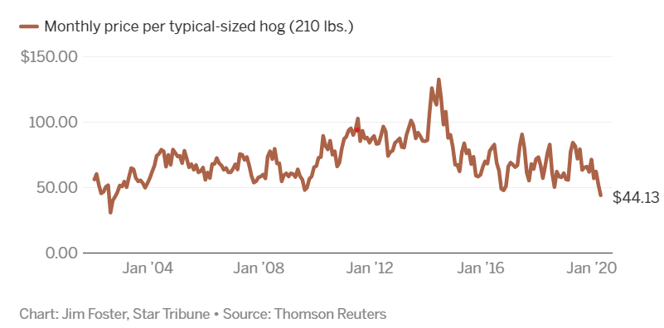
Misc. Statistics
Midwest represents 46% of the nation’s pork processing capacity
Thirteen of the top 20 pork packaging plants
Hog Prices
Price per pound for lean hog has dropped about 20 cents
Approx. $42 per animal ($62 in February, ~30% decrease)
Lowest hog futures since 2002
Farmers projected to lose $25 per head
Cattle Prices
Dropped 17% since late February
United Food and Commercial Workers International Union
1,500+ members have been infected with COVID-19
30 have died

Slide 9
President Trump Executive Order
Expected to sign order to keep meat packing plants open
Deem them “critical infrastructure”
This is a risk for meat packing employees
5,000 meatpacking workers and 1,500 food processing workers have been directly impacted by COVID-19
At risk employees could be protected from working
Age 65+

Slide 10
Additional
“There are no government agencies tracking illnesses among food industry workers nationwide”
https://www.nytimes.com/2020/04/13/business/coronavirus-food-supply.html?smtyp=cur&smid=tw-nytimes
Employees feel pressured to work
Not only do plant closings affect employees, it also harms other plants production if they rely on others for certain products. E.g. Sioux Falls sends Martin City ham
Many pigs of pigs will be euthanized if meatpacking capacity isn’t restored
3 to 5 million pigs are expected to be euthanized
Overall, 19% of pork production has been stopped as slaughterhouses continue to close

Slide 11
Sources
https://www.startribune.com/sioux-falls-plant-closing-is-risk-to-pork-supply-but-plenty-of-others-are-open/569602452/?refresh=true (Sioux Falls plant)
https://www.smithfieldfoods.com/press-room/company-news/smithfield-foods-to-close-sioux-falls-sd-plant-indefinitely-amid-covid-19 (Smithfield Sioux Falls)
https://www.startribune.com/with-restaurants-closed-a-bacon-backup-is-building-in-minnesota-and-prices-are-plunging/569470222/ (Hog prices)
https://www.kcrg.com/content/news/Tyson-Foods-suspends-Columbus-Junction-plant-after-COVID-19-outbreak-569417671.html (Tyson Iowa plant)
https://www.nytimes.com/2020/04/09/us/coronavirus-chicken-meat-processing-plants-immigrants.html?searchResultPosition=1 (Tyson Georgia)
https://www.cpr.org/2020/04/13/state-closes-jbs-meatpacking-plant-for-at-least-two-weeks-while-workers-are-tested-for-covid-19/ (JBS Greeley Colorado/Pennsylvania)
https://www.inquirer.com/business/meat-plants-pennsylvania-cargill-jbs-souderton-covid-20200409.html (Cargill Hazleton Pa)
https://www.startribune.com/smithfield-foods-closes-plants-in-wisconsin-missouri/569687722/ (Wisconsin and Missouri)
https://www.inquirer.com/jobs/labor/souderton-jbs-hazelton-cargil-meat-packing-workers-safety-osha-coronavirus-20200413.html (JBS Souderton PA)
https://www.ecowatch.com/meat-processing-plants-coronavirus-2645711732.html?rebelltitem=1#rebelltitem1 (List of plant closings)
https://www.reuters.com/article/us-health-coronavirus-meat-factbox/factbox-coronavirus-spread-closes-north-american-meat-plants-idUSKCN21V09W (Similar list of plant closings)
https://www.desmoinesregister.com/story/news/2020/04/14/testing-rural-iowa-covid-19-coronavirus-tyson-food-pork-processing/2989203001/ (Columbus Junction, IA, COVID-19 cases #)
https://www.startribune.com/jennie-o-closes-two-turkey-plants-in-willmar-after-14-workers-test-positive-for-covid-19/569926532/ (Jennie-O Willmar MN)
https://www.channel3000.com/green-bay-beef-production-facility-temporarily-closing-to-slow-spread-of-coronavirus/ (JBS Green Bay)
https://thehill.com/business-a-lobbying/business-a-lobbying/494885-focus-grows-on-food-processing-plants-amid-new (JBS Green Bay)
https://www.nbc15.com/content/news/Nebraska-farmers-fear-euthanizing-hogs-as-meat-processing-plants-close-570012071.html (Hog euthanizing)

Slide 12
Sources
https://www.startribune.com/first-covid-19-case-confirmed-at-pork-plant-in-worthington-minn/569731152/ (Worthington Minnesota)
https://www.gazettextra.com/news/health_care/coronavirus/birds-eye-food-processing-plant-geneva-lake-manor-suffer-covid-19-outbreaks/article_3b3faa00-0ba9-5c82-896b-0bb15e517c2a.html#utm_campaign=blox&utm_source=twitter&utm_medium=social (Birds Eye)
https://finance.yahoo.com/news/iowa-sends-national-guard-troops-225054924.html (Iowa National Guard)
https://wrex.com/2020/04/21/outbreak-in-covid-19-cases-forces-shutdown-of-rochelle-foods-plant/ (Rochelle, IL)
https://www.chicagotribune.com/coronavirus/ct-nw-coronavirus-tyson-iowa-pork-plant-20200422-2w2cimeu2ffubeptn647hwaeyi-story.html (Waterloo Iowa)
https://www.reuters.com/article/us-health-coronavirus-tyson-foods/tyson-to-shutter-beef-facility-as-workers-undergo-coronavirus-testing-idUSKCN2253BK (Pasco Washington)
https://thehill.com/policy/healthcare/494349-cdc-makes-recommendations-to-south-dakota-pork-plant-working-on-nationwide (Sioux falls CDC)
https://www.reuters.com/article/us-health-coronavirus-tyson-foods/coronavirus-forces-tyson-foods-to-shutter-two-major-u-s-pork-plants-idUSKCN2241ZV (Tyson- Logansport and Waterloo
https://abcnews.go.com/Politics/trump-sign-executive-order-meat-processing-plants-open/story?id=70389089 (Executive order)

